Slide 1
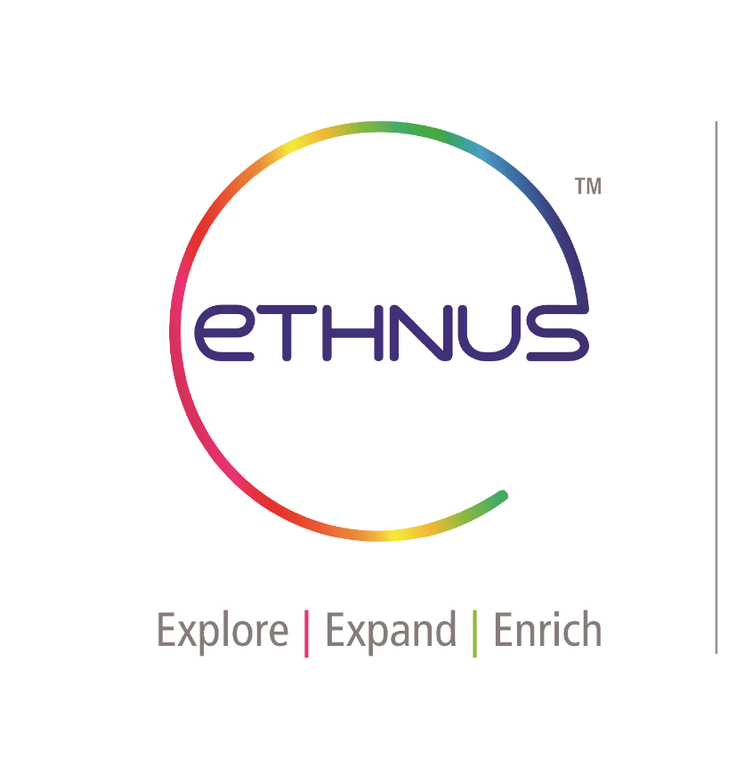
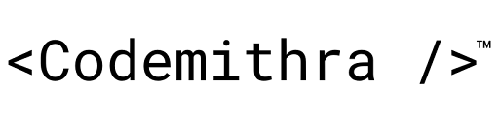

Slide 2
TOPICS
DSN4097 INTERNSHIP
FINAL REVIEW
CAT B : MERN FULL STACK INTERNSHIP
SUBMITTED BY:
TSP ABHISHEK (20BCE10012)

Slide 3
SELF INTRODUCTION
My name is TSP ABHISHEK. I am from Raipur , CG currently I am pursuing my Bachelor’s in computer science & engineering from Vellore Institute of Technology. I currently have a GPA of 8.18 out of 10.
My technical skills include programming in Java and I have a strong grasp in full stack in java and JavaScript along with a good understanding of Object Oriented Programming. While working in several team projects I implemented best version control practices and followed the Software Development Life Cycle closely.

Slide 4
Why MERN Full Stack Internship
Comprehensive Learning : The MERN stack is a popular and powerful technology stack for web development. By enrolling in this internship program, participants can gain comprehensive knowledge and hands-on experience in all aspects of full-stack web development, including frontend and backend technologies, database management, and server-side scripting
Industry Relevance: The MERN stack is widely used by tech companies worldwide to build scalable and modern web applications. By mastering this technology stack, interns can enhance their employability and career prospects in the rapidly growing field of web development.

Slide 5
Why MERN Full Stack Internship
Practical Experience: Ethnus Codemithra's internship program emphasizes practical learning through real-world projects and assignments. Interns will have the opportunity to work on live projects, collaborate with experienced mentors, and gain valuable industry insights, thereby enhancing their practical skills and confidence in web development.
Mentorship and Support: Ethnus Codemithra provides personalized mentorship and support to interns throughout the duration of the internship program. Experienced mentors guide interns, provide feedback on their work, and help them overcome challenges, ensuring a supportive learning environment conducive to skill development.

Slide 6
OBJECTIVE
Job Placement
Leverage the skills and experience gained during the internship to land entry-level or junior developer positions at tech companies, startups, or digital agencies.
Career Advancement
Acquiring new skills and expanding knowledge of full-stack web development, one can pursue opportunities for promotions, salary increases, or transitions to more challenging roles within one’s organizations.
Personal projects and Portfolio Building
One may use the knowledge and experience gained during the internship to work on personal projects or build a professional portfolio.
Certification and Recognition
Certification can enhance their credibility, marketability, and prospects for career advancement.

Slide 7
Ethnus Codemithra
Industry-Relevant Training
Ethnus Codemithra offers industry-relevant training programs in software development, data science, and IT infrastructure, ensuring that students acquire skills that are in high demand in the job market.
Practical Learning Approach
The institute emphasizes practical, hands-on learning experiences, providing students with real-world projects and simulations to enhance their problem-solving abilities and prepare them for the challenges of the tech industry.
Personalized Mentorship
Ethnus Codemithra provides personalized mentorship and support to students, guiding them through their learning journey and helping them achieve their career goals in the rapidly evolving tech landscape.

Slide 8
Ethnus Codemithra
MISSION STATEMENT
Empowering individuals with practical tech skills for success in the digital age.
BACKGROUND
Founded by experienced professionals passionate about tech education, Ethnus Codemithra aims to bridge the gap between education and industry. With a strong focus on practical learning and personalized mentorship, it has quickly established itself as a trusted name in the tech education sector, empowering students to excel in their careers in software development, data science, and IT infrastructure.

Slide 9


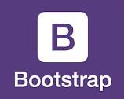
PROJECT NAME
Real Estate Website
(E-COMMERCE WEBSITE)

Slide 10
PROJECT OVERVIEW
KEY COMPONENTS
Product Catalog - Comprehensive listing of products with detailed descriptions and images.
Searching Functionality - Search bar and filters to help users find specific products easily.
Consumer acess – Accessibility to the consumers to pick their right Homes
Payment Gateway - Integration with secure payment gateways to facilitate smooth transactions.
Management - System for managing all the things in the structured way for easy way of managing things.

Slide 11
Methodology/Approach
React.js
React.js is a powerful JavaScript library for building user interfaces. It allows developers to create interactive and reusable UI components that efficiently update and render changes when the underlying data changes.
Node.js
Node.js is a runtime environment that allows developers to run JavaScript on the server-side. It provides an event-driven, non-blocking I/O model that makes it efficient and scalable for building network applications. Node.js uses the V8 JavaScript engine, which provides high-performance execution of JavaScript code.
Bootstrap Framework
Bootstrap is a popular front-end framework that provides a comprehensive set of CSS and JavaScript components, styles, and utilities for building responsive and visually appealing web applications. It was developed by Twitter and is now maintained as an open-source project. Bootstrap simplifies the process of designing and structuring web pages by providing a grid system, responsive breakpoints, and a wide range of pre-built UI components.

Slide 12
Objectives of this externship
The objective of the project is to address the shortcomings of existing e-commerce platforms by an online shopping website that prioritizes user experience. This involves implementing user-friendly features such as intuitive navigation, streamlined checkout processes, and a wide range of payment options. By focusing on enhancing 3 usability and convenience, the project aims to provide users with a seamless and enjoyable shopping experience. Additionally, the objective includes demonstrating the effectiveness of these improvements through user feedback and testing, ultimately
establishing "Shop Bag" as a leading e-commerce destination
known for its exceptional user experience

Slide 13
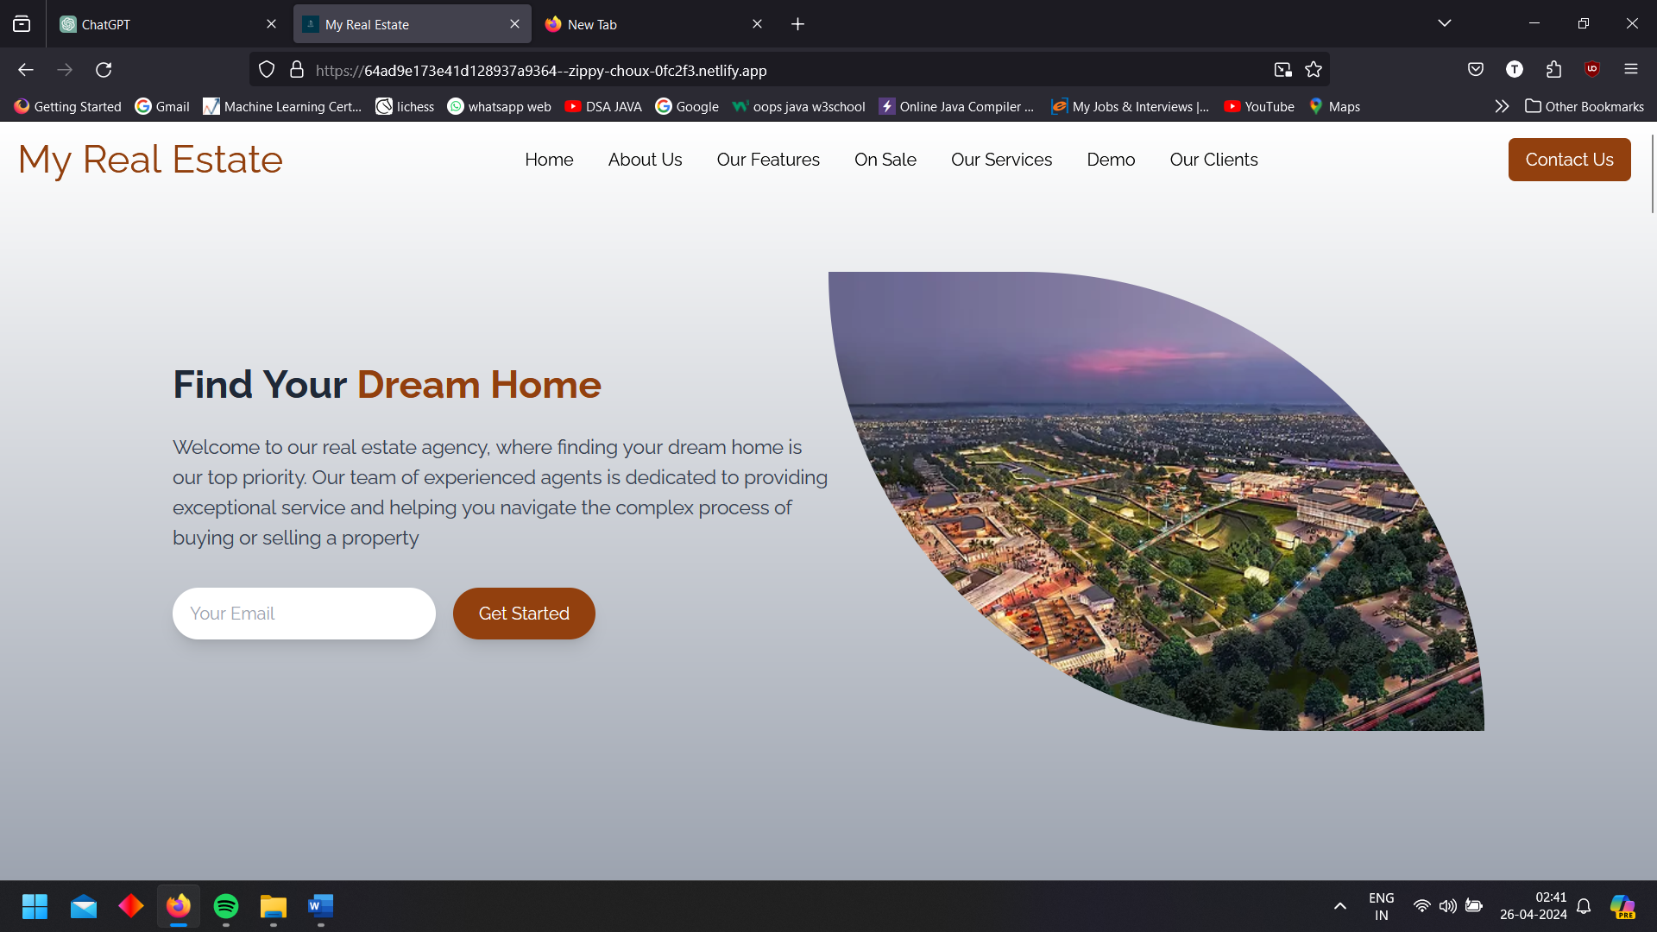
ScreenShots
Sign up page
Sign in page

Slide 14
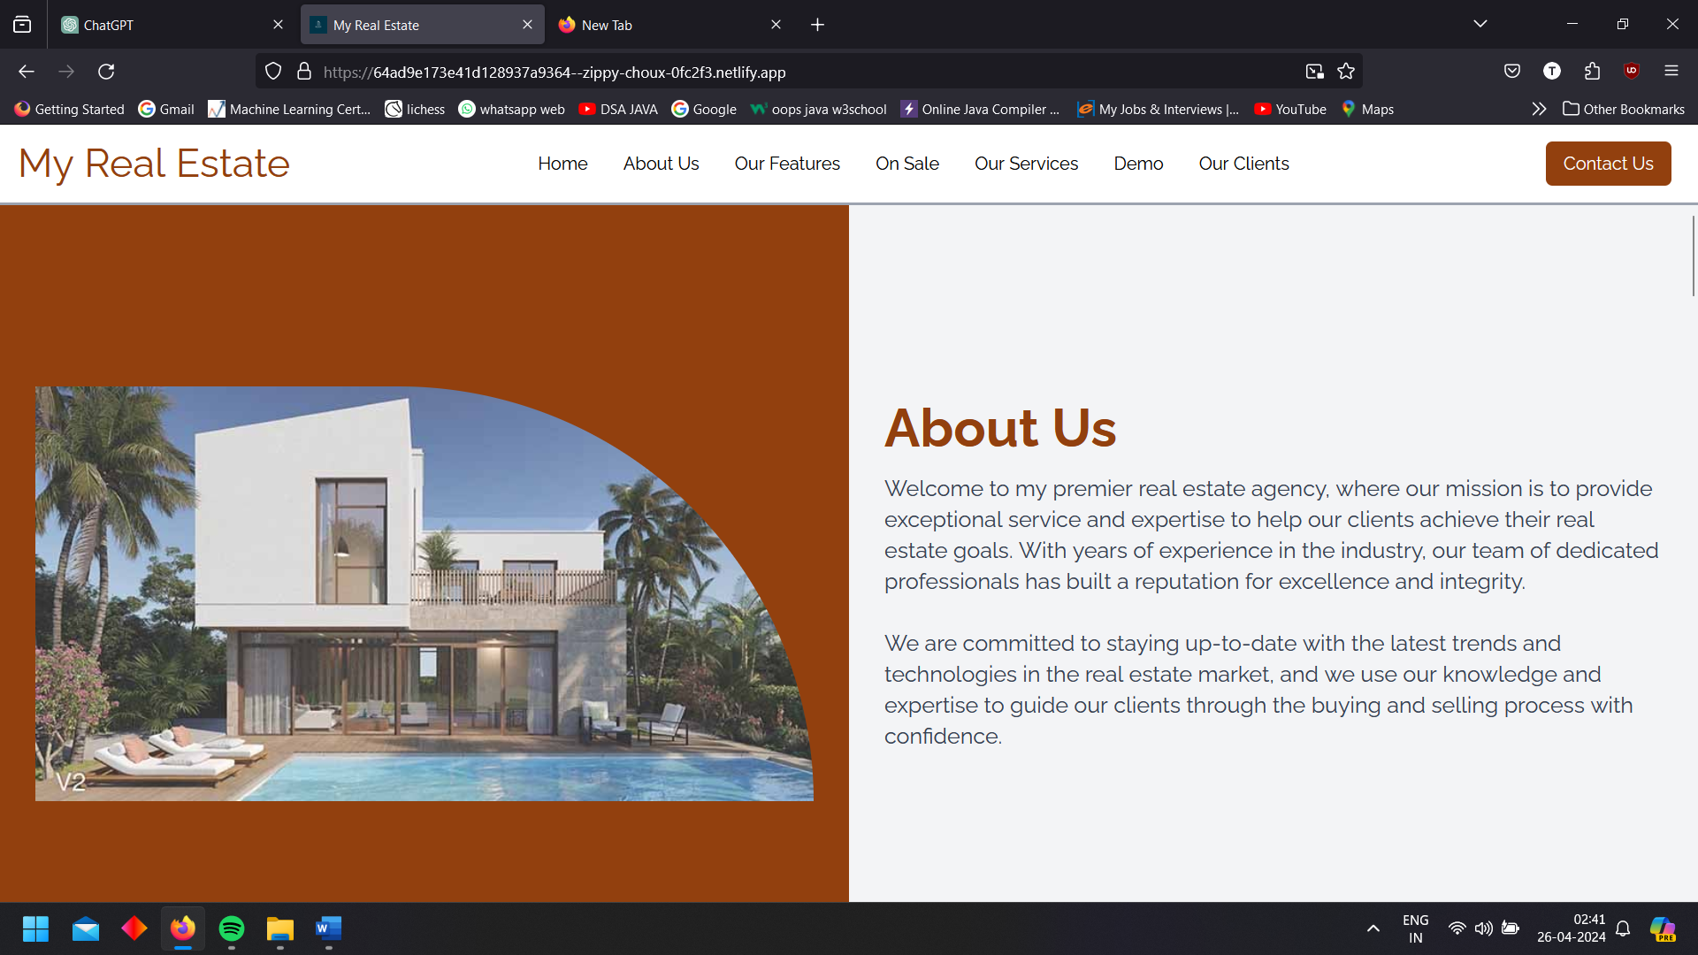
ScreenShots
View Page
Payment Page

Slide 15


Acknowledgement
We would like to express our sincere gratitude to ETHNUS MERN STACK for providing us with the opportunity to undertake this project under the guidance of Shankar Narayanan. His support and valuable suggestions were instrumental in ensuring the successful completion of this project.
We would also like to extend our heartfelt appreciation to all our friends who contributed to the accomplishment of this project.
Thank you.

Slide 16
RESULT
The Real estate website project, developed using the MERN stack, has effectively streamlined shopping processes and significantly improved user experience. The project has laid a strong foundation for a modern and efficient e-commerce system. By addressing the encountered challenges and focusing on future enhancements, the project paves the way for further advancements in the field of travel technology.
To sum it up, the E-commerce website project, built using the MERN stack, has effectively optimized shopping procedures and significantly enhanced user satisfaction. The MERN stack’s versatility and robustness have played a crucial role in creating a scalable and reliable online shopping platform.
Link- https://64ad9e173e41d128937a9364--zippy-choux-0fc2f3.netlify.app/

Slide 17

THANK YOU
https://learn.codemithra.com

